Slide 1
Cryptography for electronic voting
Bogdan Warinschi
University of Bristol

Slide 2
Aims and objectives
Cryptographic tools are amazingly powerful
Models are useful, desirable, and difficult to get right
Cryptographic proofs are not difficult
Me: Survey basic cryptographic primitives and their models
Me: Sketch one (several?) cryptographic proofs
You (and me): Ask questions
You: I assume you know groups, RSA, DDH

Slide 3

Useful, desirable, difficult to get

Slide 4
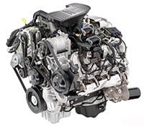
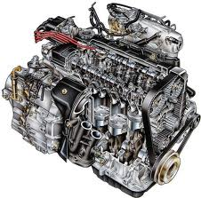
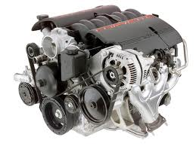
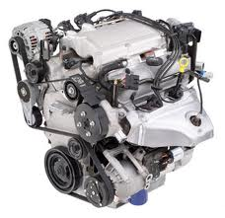
Design-then-break paradigm
…attack found
…attack found
…attack found
…no attack found
Guarantees: no attack has been found yet

Slide 5
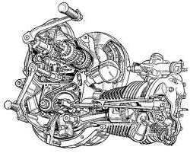
Security models
Mathematical descriptions:
What a system is
How a system works
What is an attacker
What is a break
Advantages: clarify security notion; allows for security proofs (guarantees within clearly established boundaries)
Shortcomings: abstraction – implicit assumptions, details are missing (e.g. trust in hardware, side-channels)

Slide 6
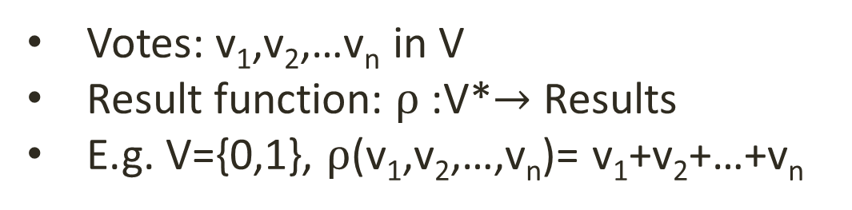
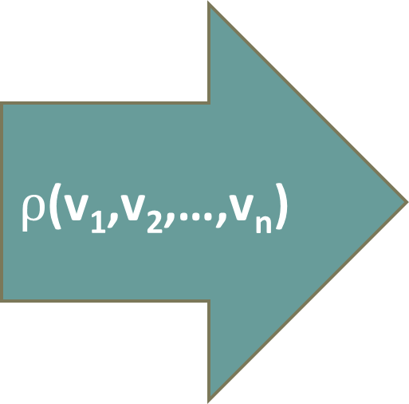
Voting scheme
v₁
$ρ$(v₁,v₂,…,v_{n})
v₂
v_{n}
Votes: v₁,v₂,…v_{n} in V
Result function: $ρ$:V*$→$ Results
E.g. V={0,1}, $ρ$(v₁,v₂,…,v_{n})= v₁+v₂+…+v_{n}

Slide 7
Complex elections
2 candidates; majority decision
N candidates:
  Limited vote: vote for a number t of candidates
  Approval vote: vote for any number of candidates
  Divisible vote: distribute t votes between candidates
  Borda vote: t votes for the first preference, t-1 for the second, etc

Slide 8
Wish list
Eligibility: only legitimate voters vote; each voter votes once
Fairness: voting does not reveal early results
Verifiability: individual, universal
Privacy: no information about the individual votes is revealed
Receipt-freeness: a voter cannot prove s/he voted in a certain way
Coercion-resistance : a voter cannot interact with a coercer to prove that s/he voted in a certain way

Slide 9
Today: privacy
Privacy-relevant cryptographic primitives
  Commitment schemes, blind signature schemes, asymmetric encryption, secret sharing
Privacy-relevant techniques
  Homomorphicity, rerandomization, threshold cryptography
Security models:
  for several primitives and for vote/ballot secrecy
Voting schemes:
  FOO, Minivoting scheme

Slide 10
Tomorrow: (mainly) verifiability
What’s left of privacy
Verifiability-relevant cryptographic primitives
  Zero knowledge
  Zero knowledge
  Zero knowledge
  Applications of zero knowledge
The Helios internet voting scheme

Slide 11
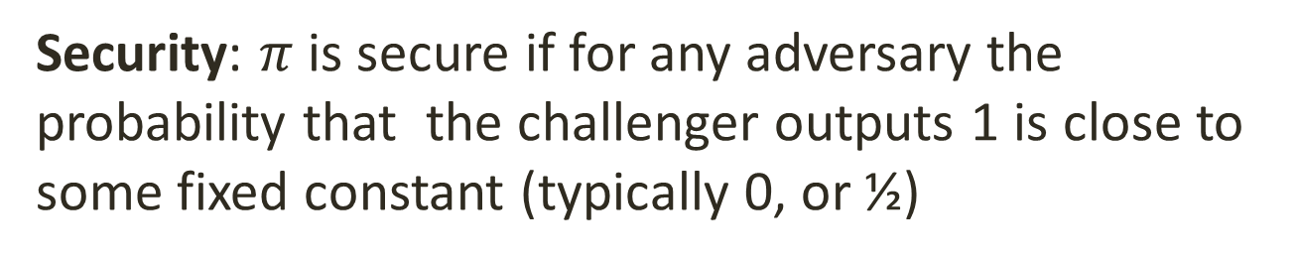

Game based models
$$π$$
Challenger
Query
Answer
0/1
Security: $π$ is secure if for any adversary the probability that the challenger outputs 1 is close to some fixed constant (typically 0, or ½)

Slide 12
A voting scheme

Slide 13
Fujisaki Okamoto Ohta [FOO92]
Voters
Election authorities
Registration phase
Voting phase
Tallying phase
Tallying authorities

Slide 14
FOO - Registration
My vote

Slide 15
FOO - Registration
Special glue
Can only be unglued with

Slide 16
FOO - Registration
Carbon paper

Slide 17
FOO - Registration

Slide 18
FOO - Registration
John Smith

Slide 19
FOO - Registration
John Smith : registered voter who didn’t vote yet
John Smith

Slide 20
FOO - Registration
Valid!

Slide 21
FOO - Registration
Valid!

Slide 22
FOO - Registration
Valid!

Slide 23
FOO – Voting phase
Valid!
Valid!
Valid!
Valid!

Slide 24
FOO – Voting phase
Anonymous Channel
Valid!
Valid!
Valid!
Valid!

Slide 25
FOO – Tallying phase
Anonymous Channel
Valid!
Valid!
Valid!
Valid!

Slide 26
FOO – Tallying phase
Anonymous Channel
Valid!
Valid!
Valid!
Valid!

Slide 27
FOO – Tallying phase
…and the winner is:
Anonymous Channel
Vote 1
Valid!
Vote 2
Valid!
Vote 3
Valid!
Vote N
Valid!

Slide 28
Cryptographic implementation

Slide 29
Digital signature schemes
Setup
params
Kg
ν
sk
vk
Sign_{sk}
s
Verify_{vk}
m
Yes/no
m

Slide 30
Digital signature schemes
Syntax:
  Keygen(ν): generates (sk,vk) secret signing key, verification key
  Sign(sk,m): the signing algorithm produces a signature s on m
  Verify(vk,m,s): the verification algorithm outputs accept/reject

Slide 31



Unforgeability under chosem message attack (UF-CMA)
Good definition?
Defining the security of$π$=(Setup,Kg,Sign,Verify)
$$π$$
Public Key
par $←$ Setup(n)
(vk,sk ) $←$ Kg (par)
s_{i} $←$Sign_{sk}(m_{i})
win $←$ Verify(vk,m*,s*)
and m*≠m_{i}
vk
m_{i}
s_{i}
Forgery(m*,s*)
UF-CMA security: ∀ PPT attackers ∃ negligible function f ∃ n₀ ∀ security parameters n ≥ n₀ Prob [win] ≤ f(n)
win

Slide 32
Full Domain Hash
Syntax:
  Keygen(ν): generate RSA modulus N=PQ, and d and e such that ed=1 mod Φ(N). Set H be a good hash function that hashes in Z_{N}*. Set vk=(H,N,e) and sk=(H,N,d).
  Sign((H,N,d),m): output H(m)^{d} mod N
  Verify((N,e),m,s): accept iff s^{e}= H(m) mod
Security: UF-CMA secure in the random oracle model under the RSA assumption

Slide 33
Blind digital signature schemes
Setup
params
Kg
ν
sk
vk
Blind -Sign
S_{sk}
U
s
Verify_{vk}
Yes/no
m

Slide 34
Blind digital signature schemes
Syntax:
  Keygen(ν): generates (sk,vk) secret signing key, verification key
  Blind-Sign: protocol between user U(m,vk) and signer S(sk); the user obtains a signature s on m
  Verify(vk,m,s): the verification algorithm outputs accept/reject

Slide 35
Blind digital signature schemes
Security:
  Blindness: a malicious signer obtains no information about the message being signed
  Unforgeability:...

Slide 36



Chaum’s blind signature scheme
Key generation(): generate RSA modulus N=PQ, and d and e such
that ed=1 mod Φ(N).
Set vk=(N,e) and sk=(N,d)
Blind-sign:
$b$ = $H(m)$
${t=b}^{d}={(H(m))}^{d} mod N$
User (m,(N,e))
Signer (d,N)
gcd(r, N) = 1
$s=t={H(m)}^{d} mod n$

Slide 37



Chaum’s blind signature scheme
Key generation(): generate RSA modulus N=PQ, and d and e such
that ed=1 mod Φ(N).
Set vk=(N,e) and sk=(N,d)
Blind-sign:
$b$ = $H(m)r^{e} mod N$
${t=b}^{d}={(H(m)r^{e})}^{d} mod N$
User (m,(N,e))
Signer (d,N)
gcd(r, N) = 1
$s=t/r={H(m)}^{d} mod n$

Slide 38
Commitment schemes
Temporarily hide a value, but ensure that it cannot be changed later
1st stage: Commit
  Sender electronically “locks” a message in an envelope and sends the envelope to the Receiver
2nd stage: Decommit
  Sender proves to the Receiver that a certain message is contained in the envelope

Slide 39
Commitment schemes
Setup
ν
params
params
C,d
Decommit
Commit
m
Yes/no

Slide 40
Commitment schemes
Syntax:
  Setup(): outputs scheme parameters
  Commit(x;r): outputs (C,d):
    C is a commitment to x
    d is decommiting information
  Decommit(C,x,d): outputs true/false
Functionality: If (C,d) was the output of Commit(x;r) then Decomit(C,x,d) is true

Slide 41
Security of Commitment Schemes
Hiding
  The commitment does not reveal any information about the committed value
    If receiver is probabilistic polynomial-time, then computationally hiding; if receiver has unlimited computational power, then perfectly hiding
Binding
  There is at most one value that an adversarial commiter can successfully “decommit” to
    Perfectly binding vs. computationally binding

Slide 42
Exercises
(easy): Can a commitment scheme be both perfectly hiding and binding?
(tricky): Let G be a cyclic group and g a generator for G. Consider the commitment scheme (Commit, Decommit) for elements in {1,2,…,|G|}:
  Commit(x) output C=g^{x} and d=x
  Decommit(C,d) is 1 if g^{x}=C and 0 otherwise
Is it binding (perfectly, computationally?)
Is it hiding (perfectly/computationally)?

Slide 43
Pedersen Commitment Scheme
Setup: Generate a cyclic group G of prime order, with generator g. Set
  h=gª for random secret a in [|G|]
  G,g,h are public parameters (a is kept secret)
Commit(x;r): to commit to some x∈ [|G|], choose random r∈ [|G|]. The commitment to x is C=g^{x}h^{r} (Notice that C=g^{x}(gª)^{r}=g^{x+ar})
Decommit(C,x,r): check C=g^{x}h^{r}

Slide 44
Security of Pedersen Commitments
Perfectly hiding
  Given commitment c, every value x is equally likely to be the value commited in c
    Given x, r and any x’, exists a unique r’ such that g^{x}h^{r} = g^{x’}h^{r’} r’ = (x-x’)a⁻¹ + r (but must know a to compute r’)
Computationally binding
  If sender can find different x and x’ both of which open commitment c=g^{x}h^{r}, then he can solve discrete log
    Suppose sender knows x,r,x’,r’ s.t. g^{x}h^{r} = g^{x’}h^{r’}
    Because h=gª mod |G|, this means x+ar = x’+ar’ mod |G|
    Sender can compute a as (x’-x)(r-r’)⁻¹

Slide 45
Fujisaki Okamoto Ohta (FOO)
(medium) Specify the Fujisaki, Okamoto, Ohta protocol [you may assume two-move blind signing protocols, like Chaum’s]

Slide 46
Some difficulties with FOO
Requires anonymous channels (Tor?)
Voters involved in all of the tallying phases
Only individual verifiability

Slide 47
Asymmetric Encryption schemes

Slide 48
Asymmetric encryption
Setup
params
Kg
ν
pk
sk
Enc_{pk}
C
Dec_{sk}
m
m

Slide 49
Syntax
Setup(ν): fixes parameters for the scheme
KG(params): randomized algorithm that generates (PK,SK)
ENC_{PK}(m): randomized algorithm that generates an encryption of m under PK
DEC_{SK}(C): deterministic algorithm that calculates the decryption of C under sk

Slide 50
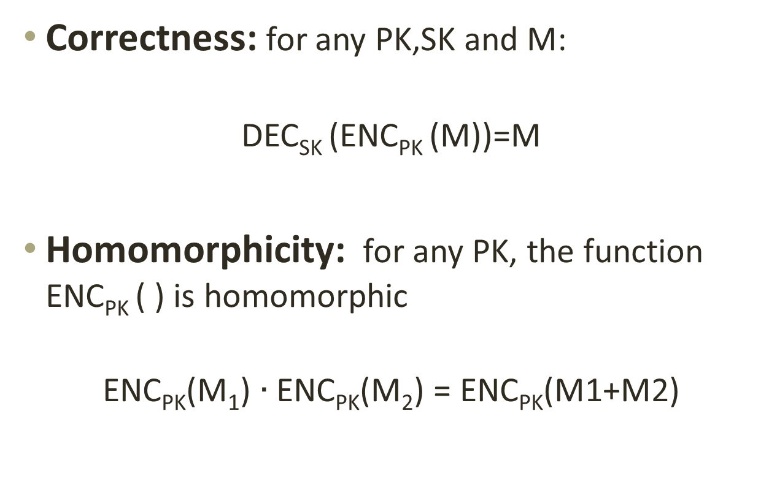
Functional properties
Correctness: for any PK,SK and M:
DEC_{SK} (ENC_{PK} (M))=M
Homomorphicity: for any PK, the function ENC_{PK} ( ) is homomorphic
ENC_{PK}(M₁) $∙$ ENC_{PK}(M₂) = ENC_{PK}(M1+M2)

Slide 51
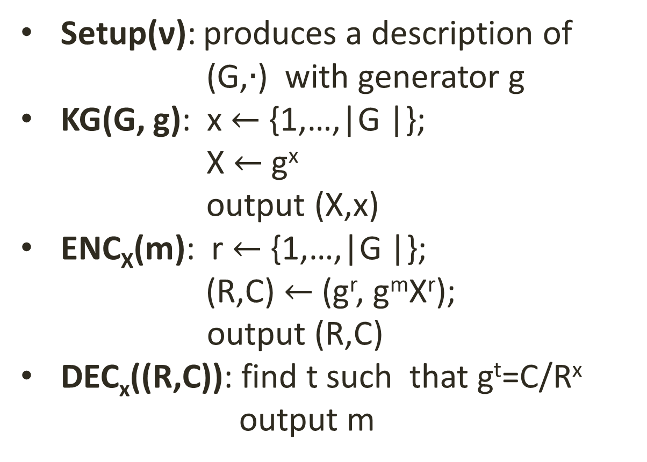
(exponent) ElGamal
Setup(ν): produces a description of (G,$∙$) with generator g
KG(G, g): x $←${1,…,|G |};
X $←$g^{x}
output (X,x)
ENC_{X}(m): r $←${1,…,|G |};
(R,C) $←$(g^{r}, g^{m}X^{r});
output (R,C)
DEC_{x}((R,C)): find t such that g^{t}=C/R^{x}
output m

Slide 52
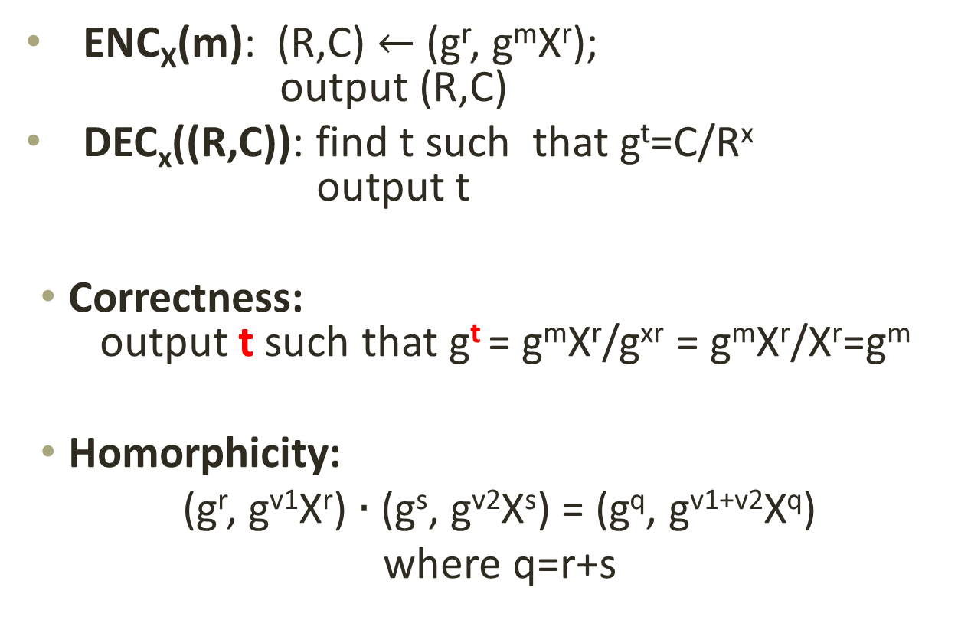
Functional properties
ENC_{X}(m): (R,C) $←$(g^{r}, g^{m}X^{r});
output (R,C)
DEC_{x}((R,C)): find t such that g^{t}=C/R^{x}
output t
Correctness:
output t such that g^{t} = g^{m}X^{r}/g^{xr} = g^{m}X^{r}/X^{r}=g^{m}
Homorphicity:
(g^{r}, g^{v1}X^{r}) $∙$ (g^{s}, g^{v2}X^{s}) = (g^{q}, g^{v1+v2}X^{q})
where q=r+s

Slide 53

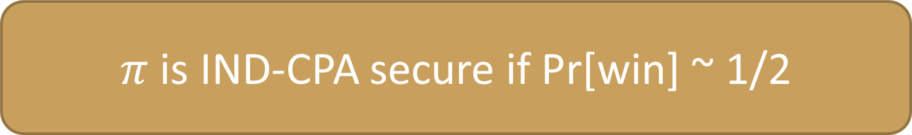

IND-CPA security
$π$is IND-CPA secure if Pr[win] ~ 1/2
$$Security for π=(Setup,Kg,Enc,Dec)$$
$$π$$
Public Key
par $←$ Setup()
(PK,SK ) $←$ Kg (par)
b$←\{0,1\}$
C $←$Enc_{PK}(M_{b})
win $←$ d=b
Good definition?
PK
M₀,M_{I}
Theorem:If the DDH problem is hard in G then the ElGamal encryption scheme is IND-CPA secure.
C
Guess d
win

Slide 54
Single pass voting scheme

Slide 55
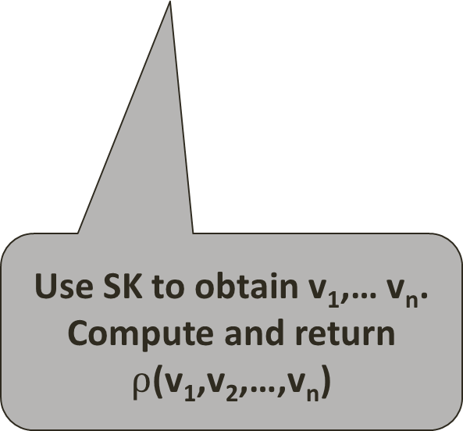
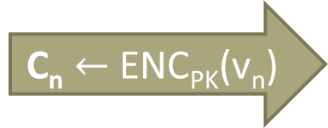
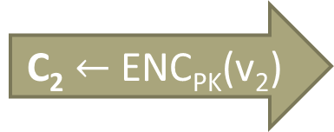
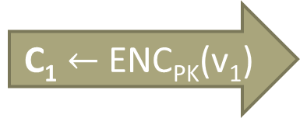
Informal
PK
BB
P₁: v₁
C₁ $←$ ENC_{PK}(v₁)
SK
C₁
P₂: v₂
C₂ $←$ ENC_{PK}(v₂)
C₂
Use SK to obtain v₁,… v_{n}. Compute and return $ρ$(v₁,v₂,…,v_{n})
P_{n}: v_{n}
C_{n} $←$ ENC_{PK}(v_{n})
C_{n}

Slide 56
Syntax of SPS schemes
Setup(ν): generates (x,y,BB) secret information for tallying, public information parameters of the scheme, initial BB
Vote(y,v): the algorithm run by each voter to produce a ballot b
Ballot(BB,b): run by the bulleting board; outputs new BB and accept/reject
Tallying(BB,x): run by the tallying authorities to calculate the final result

Slide 57
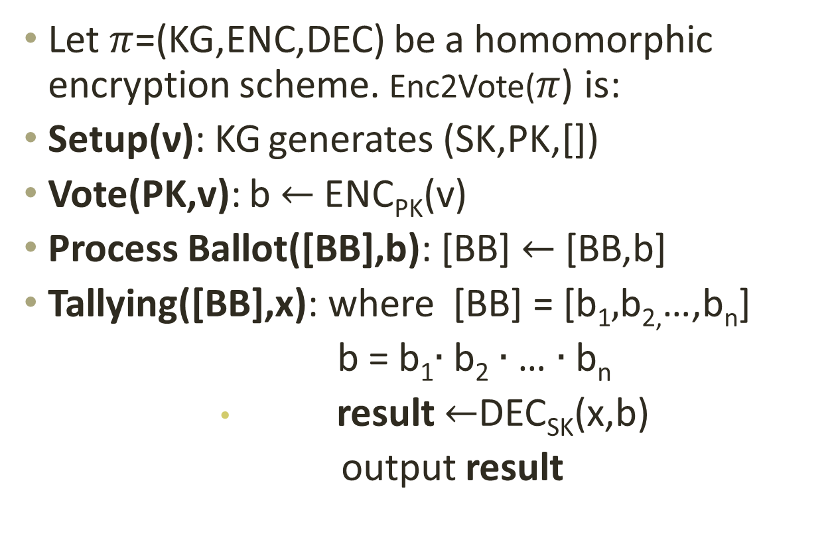
An implementation: Enc2Vote
$\text{Let} π$=(KG,ENC,DEC) be a homomorphic encryption scheme. Enc2Vote($π$) is:
Setup(ν): KG generates (SK,PK,[])
Vote(PK,v): b $←$ ENC_{PK}(v)
Process Ballot([BB],b): [BB] $←$ [BB,b]
Tallying([BB],x): where [BB] = [b₁$,$b_{2,}…,b_{n}]
b = b₁$∙$b₂ $∙$… $∙$b_{n}
              result $←$DEC_{SK}(x,b)
              output result

Slide 58
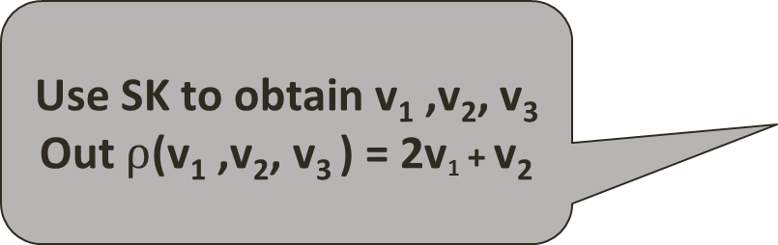

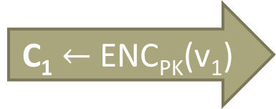
Attack against privacy
Use SK to obtain v₁ ,v₂, v₃ Out $ρ$(v₁ ,v₂, v₃ ) = 2v₁ + v₂
PK
BB
P₁: v₁
C₁ $←$ ENC_{PK}(v₁)
SK
C₁
P₂: v₂
C₂ $←$ ENC_{PK}(v₂)
C₂
FIX: weed out equal ciphertexts
P₃
C₁
C₁
Assume that votes are either 0 or 1
If the result is 0 or 1 then v₁ was 0, otherwise v₁ was 1
Notes:
Add the 2v1+v2 as the result

Slide 59
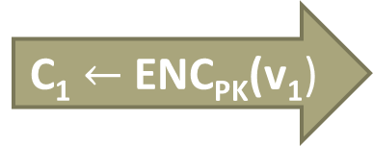
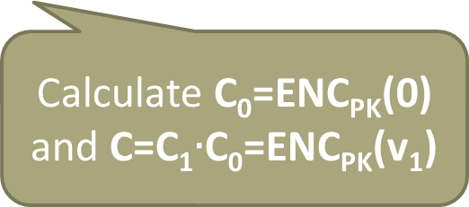
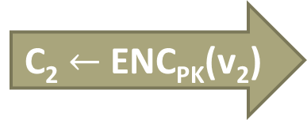
New attack
Use SK to obtain v₁ ,v₂, v₃ Out $ρ$(v₁ ,v₂, v₃ ) = 2v₁ + v₂
PK
BB
P₁: v₁
C₁ $←$ ENC_{PK}(v₁)
SK
C₁
P₂: v₂
C₂ $←$ ENC_{PK}(v₂)
C₂
FIX: Make sure ciphertexts cannot be mauled and weed out equal ciphertexts
P₃
C
C
Calculate C₀=ENC_{PK}(0)
and C=C₁$∙$C₀=ENC_{PK}(v₁)

Slide 60
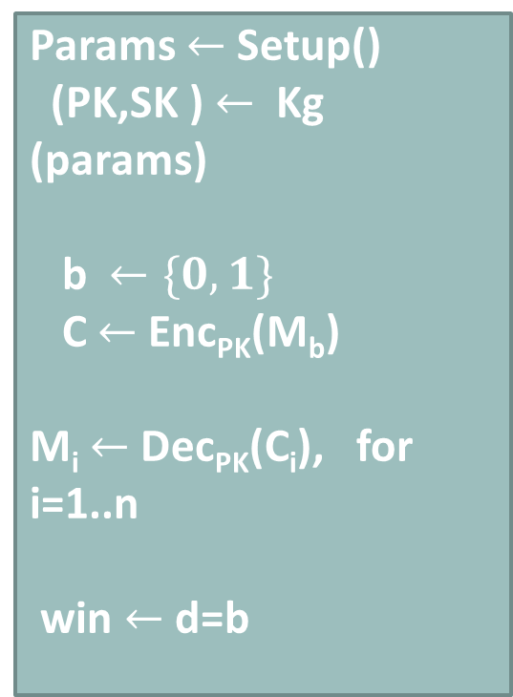

Non-malleable encryption (NM-CPA)
Good definition?
$$Nonnmalleability of π=(Setup,Kg,Enc,Dec)$$
$$π$$
Public Key
Params $←$ Setup()
(PK,SK ) $←$ Kg (params)
b$←\{0,1\}$
C $←$Enc_{PK}(M_{b})
M_{i} $←$Dec_{PK}(C_{i}), for i=1..n
win $←$ d=b
PK
M₀,M₁
C
C₁, C₂ …,C_{n}
M₁, M₂,…,M_{n}
Guess d
win

Slide 61
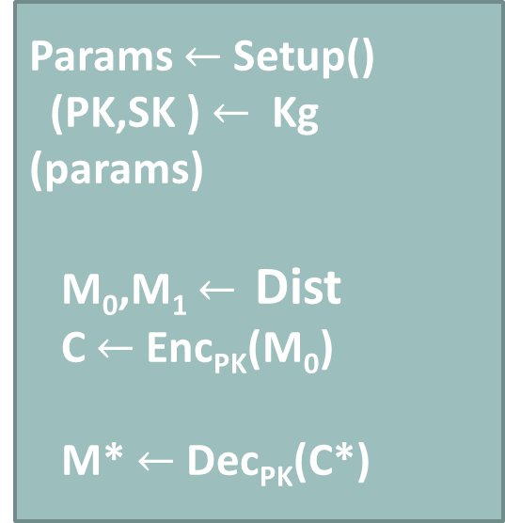
(NM-CPA) – alternative definition
$$Nonnmalleability of π=(Setup,Kg,Enc,Dec)$$
$$π$$
Public Key
Params $←$ Setup()
(PK,SK ) $←$ Kg (params)
M₀,M₁ $←$ Dist
C $←$Enc_{PK}(M₀)
M* $←$Dec_{PK}(C*)
PK
_{Dist}
C
Rel,C*
NM-CPA security: ∀ PPT attackers ∃ negligible function f such that | Prob [Rel(M₀,M*)] - Prob [Rel(M₁,M*)] | ≤ f(n)

Slide 62
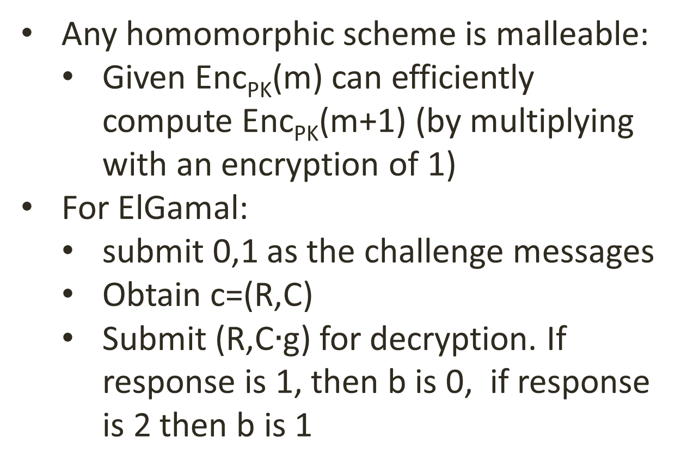
ElGamal is not non-malleable
Any homomorphic scheme is malleable:
  Given Enc_{PK}(m) can efficiently compute Enc_{PK}(m+1) (by multiplying with an encryption of 1)
For ElGamal:
  submit 0,1 as the challenge messages
  Obtain c=(R,C)
  Submit (R,C$∙$g) for decryption. If response is 1, then b is 0, if response is 2 then b is 1

Slide 63

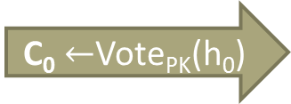



Ballot secrecy for SPS [BCPSW11]
BB₀
BB₁
PK
SK
Sees BB_{b}
C₀ $←$Vote_{PK}(h₀)
C₀
h₀,h₁
C₁ $←$ Vote_{PK}(h₁)
C₁
C
C
C
C
result
r$esult←$Tally_{SK}(BB₀)
d
win $←$ d=b
b $←\{0,1\}$
win

Slide 64
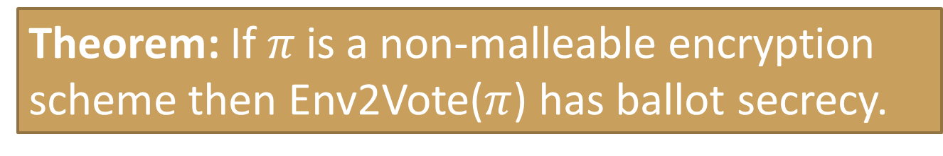

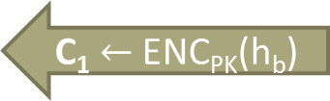
Theorem: If $π \text{i}$s a non-malleable encryption scheme then Env2Vote($π$) has ballot secrecy.
h₀,h₁
PK
PK
PK
h₀,h₁
BB
C₁ $←$ ENC_{PK}(h_{b})
C₁
C
C
SK
C₁, C₂,…, C_{t}
r$esult←$F(H₀,V)
v₁, v₂,…, v_{t}
result
d
d

Slide 65
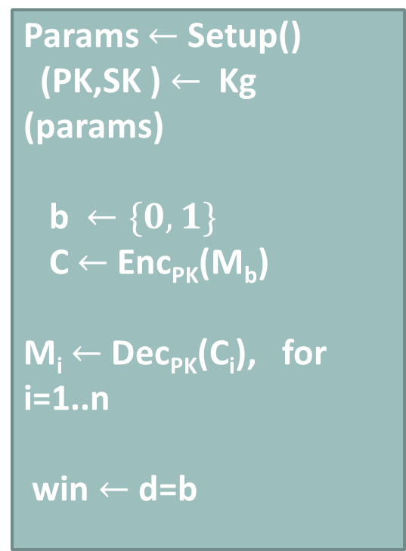
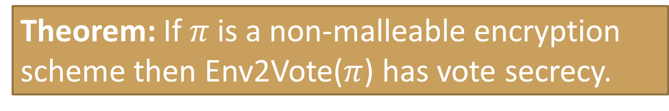
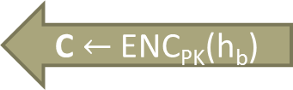
Theorem: If $π \text{i}$s a non-malleable encryption scheme then Env2Vote($π$) has vote secrecy.
h₀,h₁
PK
PK
PK
Params $←$ Setup()
(PK,SK ) $←$ Kg (params)
b$←\{0,1\}$
C $←$Enc_{PK}(M_{b})
M_{i} $←$Dec_{PK}(C_{i}), for i=1..n
win $←$ d=b
h₀,h₁
BB
C $←$ ENC_{PK}(h_{b})
C
C_{i}
C_{i}
SK
C₁, C₂,…, C_{t}
r$esult←$F(H₀,V)
v₁, v₂,…, v_{t}
result
d
d

Slide 66
Exercises
(easy) Define the hiding property for commitment schemes
(medium) Modify the ballot secrecy experiment to accommodate the FOO scheme
(difficult) Does FOO have vote secrecy?

Slide 67
More complex elections
N voters, k candidates and (say) approval voting
  Allocate pk₁,pk₂,…,pk_{k} one for each candidate
  Voter i: decide on v_{ij} in {0,1}. His ballot is:
  Tallying is done for each individual key
  Ballot size: k·|ciphertext| (Wasteful?)
Enc_{pk1}(v_{i1})
Enc_{pk2}(v_{i2})
Enc_{pk2}(v_{ik})

Slide 68
More complex elections
N voters, k candidates (N is the maximum number of votes for any candidate)
Encode the choices in a single vote:
The choices of user j encoded as: Σ_{i}v_{ij}N^{i}
K · c·|log N| (better?)
v_{i1}
v_{i2}
v_{i3}
v_{ik}
log N bits

Slide 69
Paillier encryption
Public key N=PQ=(2p+1)(2q+1)
Secret key d satisfying d=1 mod N, d=0 mod 4pq
Encrypt vote v ∈ Z_{N} using randomness R ∈ Z_{N}*
C = (1+N)^{v}R^{N} mod N²
Decrypt by computing
v = (C^{d}-1 mod N²)/N

Slide 70

Correct decryption
Public key N=PQ=(2p+1)(2q+1)
Secret key d satisfying d=1 mod N, d=0 mod 4pq
The multiplicative group Z_{N}2* has size 4Npq
We also have (1+N)^{N} = 1 + N·N + ... ≡ 1 mod N²
Correctness
C^{d} = ((1+N)^{v}R^{N})^{d} = (1+N)^{vd} R^{Nd}
= (1+N)^{vd} R^{4Npqk} ≡ (1+N)^{v} mod N²
(1+N)^{v} = 1+vN+ N²+... ≡ 1+vN mod N²
(C^{d}-1 mod N²)/N = v

Slide 71
Homomorphicity
Public key N=PQ=(2p+1)(2q+1)
Encrypt vote v ∈ Z_{N} using randomness R ∈ Z_{N}*
C = (1+N)^{v}R^{N} mod N²
Homomorphic
(1+N)^{v}R^{N} · (1+N)^{w}S^{N}
≡ (1+N)^{v+w}(RS)^{N} mod N²

Slide 72

Attack against privacy
PK
BB
P₁: v₁
C₁ $←$ ENC_{PK}(v₁)
SK
C₁
P₂: v₂
C₂ $←$ ENC_{PK}(v₂)
C₂
P₃
C₃ $←$ ENC_{PK}(v₃)
C₃

Slide 73
Attack against privacy
PK
BB
P₁: v₁
C₁ $←$ ENC_{PK}(v₁)
C₁
P₂: v₂
C₂ $←$ ENC_{PK}(v₂)
C₂
P₃
C₃ $←$ ENC_{PK}(v₃)
C₃

Slide 74
PRIVACY Preserving Tallying

Slide 75
Threshold encryption
ν
Setup
params
Kg
Combine
pk
sk₁
C
Dec_{sk1}( )
m₁
Enc_{pk}( )
m
m
C
Dec_{sk2}( )
m₂
C
Dec_{skN}( )
m_{N}

Slide 76
Threshold encryption
Syntax:
  Key Generation(n,k):
  outputs pk,vk,(sk₁, sk₂, …,sk_{n})
  Encrypt(pk,m): outputs a ciphertext C
  Decrypt(C,sk_{i}): outputs m_{i}
  ShareVerify(pk,vk,C, m_{i}): outputs accept/reject
  Combine(pk,vk,C,{m_{i1},m_{i2},…,m_{ik}}): outputs a plaintext m

Slide 77
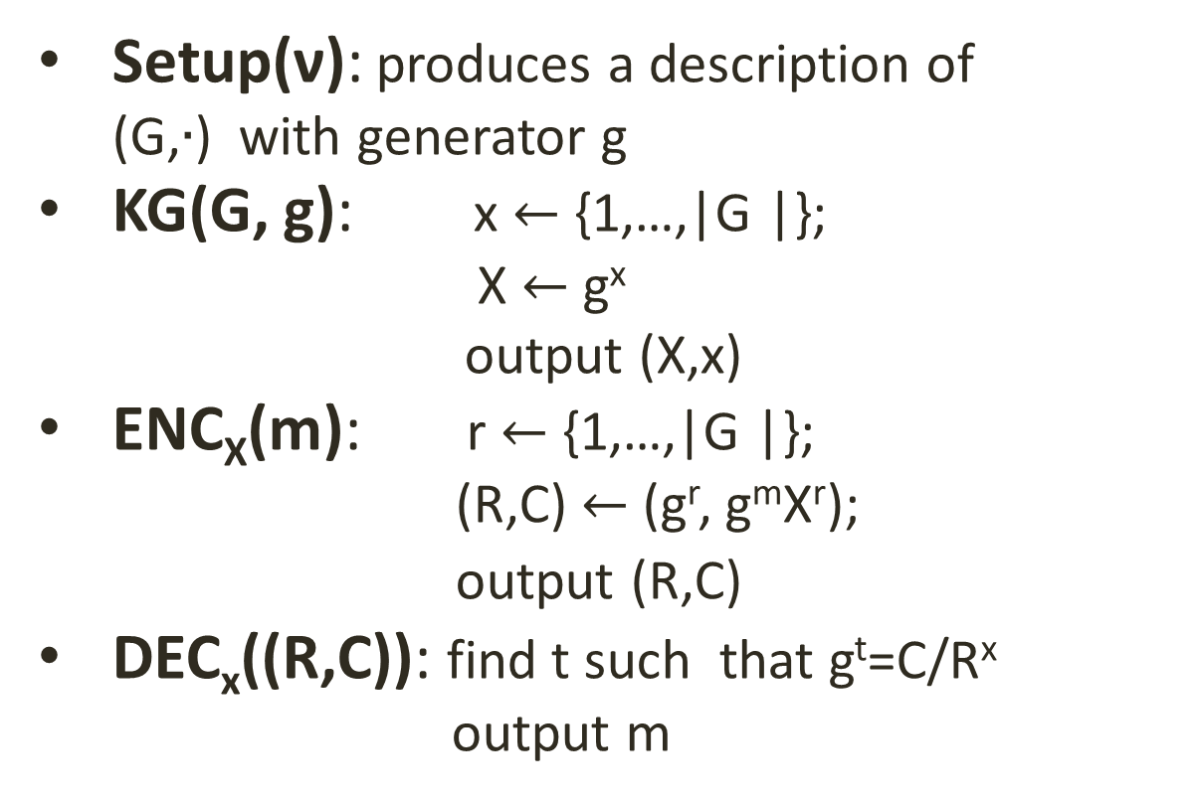
(exponent) ElGamal
Setup(ν): produces a description of (G,$∙$) with generator g
KG(G, g): x $←${1,…,|G |};
X $←$g^{x}
output (X,x)
ENC_{X}(m): r $←${1,…,|G |};
(R,C) $←$(g^{r}, g^{m}X^{r});
output (R,C)
DEC_{x}((R,C)): find t such that g^{t}=C/R^{x}
output m

Slide 78
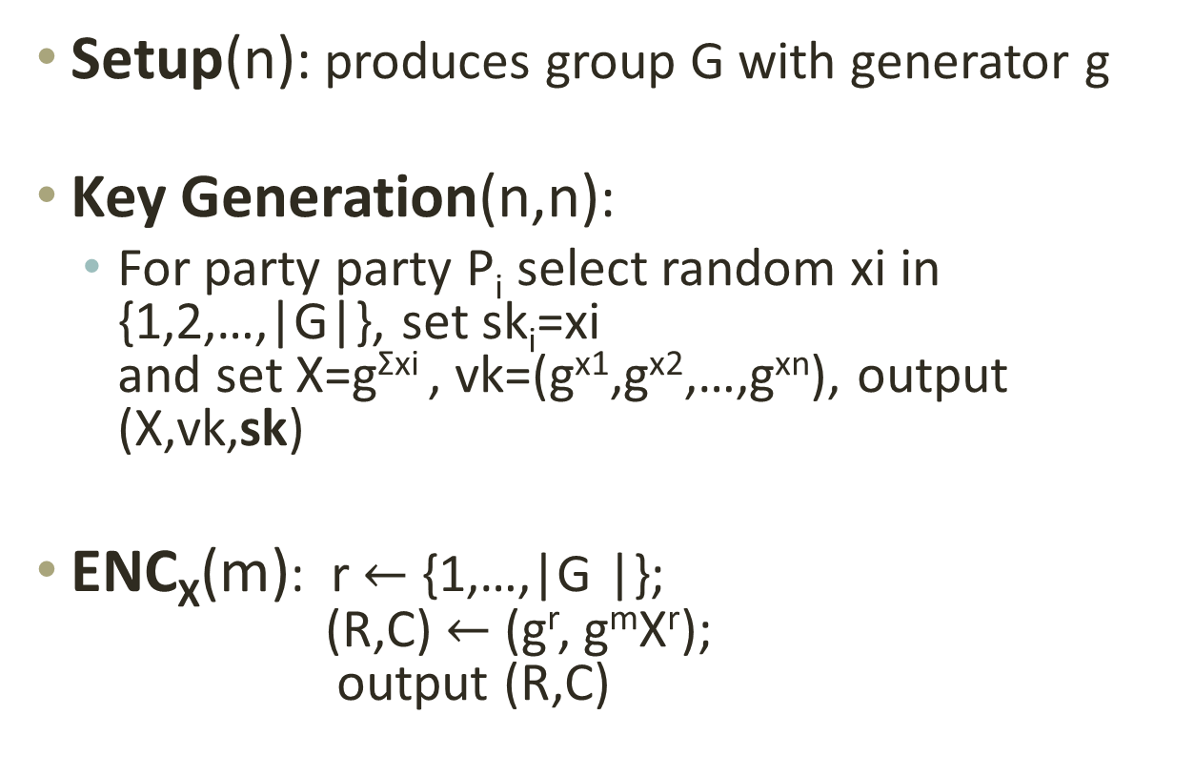
n-out-of-n threshold El-Gamal
Setup(n): produces group G with generator g
Key Generation(n,n):
  For party party P_{i} select random xi in {1,2,…,|G|}, set sk_{i}=xi
  and set X=g^{Σxi} , vk=(g^{x1},g^{x2},…,g^{xn}), output (X,vk,sk)
ENC_{X}(m): r $←${1,…,|G |};
(R,C) $←$(g^{r}, g^{m}X^{r});
output (R,C)

Slide 79
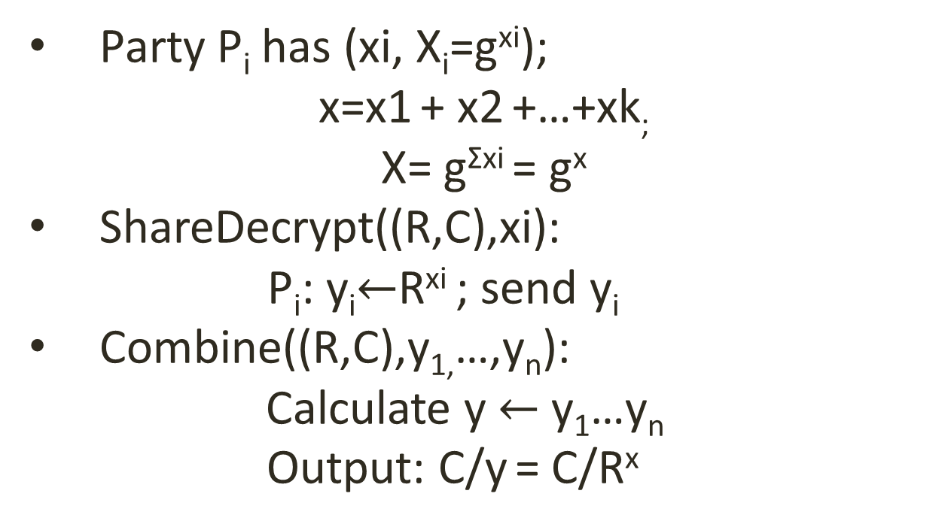
Threshold decryption
Party P_{i} has (xi, X_{i}=g^{xi});
x=x1 + x2 +…+xk;
X= g^{Σxi} = g^{x}
ShareDecrypt((R,C),xi):
P_{i}: y_{i}$←$R^{xi} ; send y_{i}
Combine((R,C),y_{1,}…,y_{n}):
Calculate y $←$ y₁…y_{n} Output: C/y = C/R^{x}

Slide 80
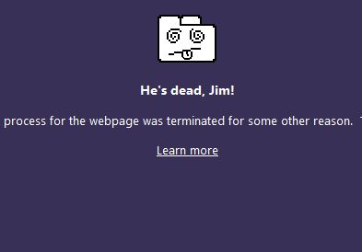
Private but not robust
…and I hid my secret key

Slide 81
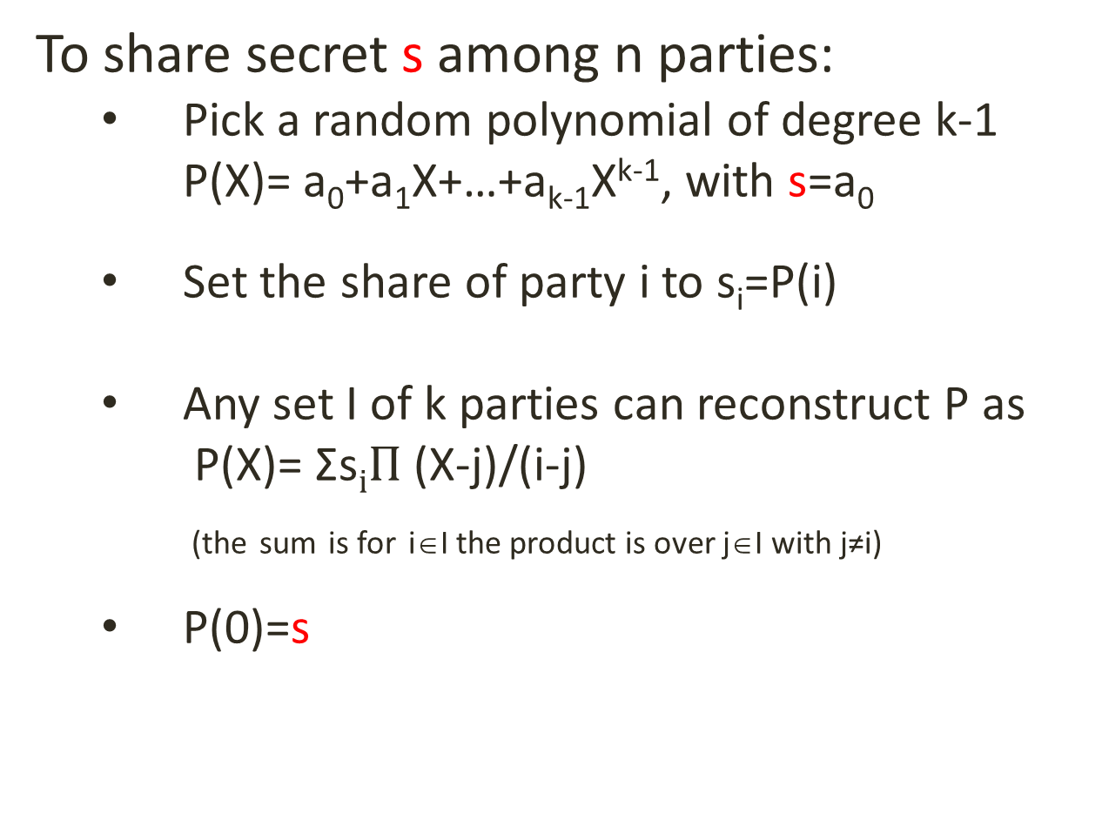
Shamir k out of n threshold secret sharing:
To share secret s among n parties:
  Pick a random polynomial of degree k-1
  P(X)= a₀+a₁X+…+a_{k-1}X^{k-1}, with s=a₀
  Set the share of party i to s_{i}=P(i)
  Any set I of k parties can reconstruct P as
  P(X)= Σs$iΠ$ (X-j)/(i-j)
  _{(the} _{sum} _{is for} i∈I the product is over j∈I with j≠i)
  P(0)=s

Slide 82
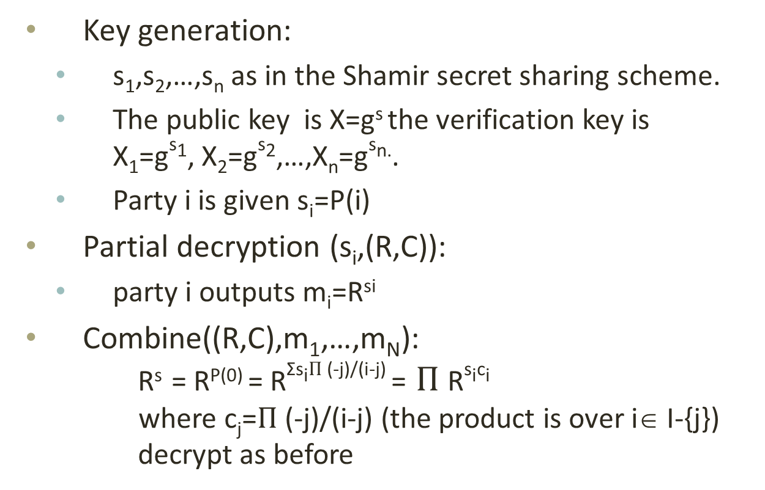
k-out-of-n threshold ElGamal
Key generation:
  s₁,s₂,…,s_{n} as in the Shamir secret sharing scheme.
  The public key is X=g^{s} the verification key is
  X₁=g^{s1}, X₂=g^{s2},…,X_{n}=g^{sn.}.
  Party i is given s_{i}=P(i)
Partial decryption (s_{i},(R,C)):
  party i outputs m_{i}=R^{si}
Combine((R,C),m₁,…,m_{N}):
R^{s} = R^{P(0)} = R^{Σsi}$Π$ ^{(-j)/(i-j)} = $Π$R^{sici}
where c_{j}=$Π$ (-j)/(i-j) (the product is over i∈ I-{j})
decrypt as before

Slide 83
Mixnets
Homomorphic tallying great, but not for complex functions
  Instead of homomorphically computing Enc_{pk}(f(v₁,v₂,…,v_{n})) simply decrypt all votes

Slide 84
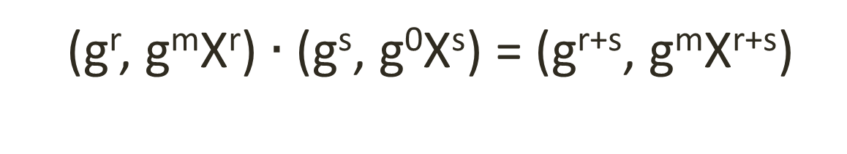
Rerandomizable encryption
vote
0
=
vote
•
Enc_{pk}(m;r) • Enc_{pk}(0;s)= Enc_{pk}(m;r+s)
(g^{r}, g^{m}X^{r}) $∙$ (g^{s}, g⁰X^{s}) = (g^{r+s}, g^{m}X^{r+s})

Slide 85
Mixnet
π
vote₁
vote _{π (2)}
vote₁
vote₂
vote _{π (N)}
vote₂
vote_{N}
vote_{N}
vote _{π (1)}

Slide 86
Mixnet
π
σ
vote₁
vote _{π (2)}
vote_{τ(1)}
vote₂
vote _{π (N)}
vote _{τ (N)}
vote_{N}
vote _{π( 1)}
vote _{τ(2)}
τ=π;σ

Slide 87
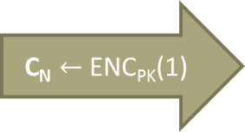
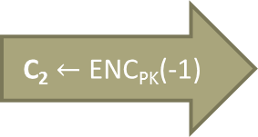
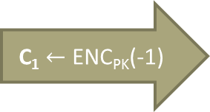
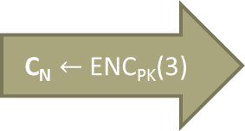
Misbehaving parties - voters
BB
π
vote₁
SK
C₁ $←$ ENC_{PK}(-1)
vote _{π (2)}
vote₂
vote _{π (N)}
C₂ $←$ ENC_{PK}(-1)
C_{N} $←$ ENC_{PK}(1)
C_{N} $←$ ENC_{PK}(3)
vote_{N}
vote _{π( 1)}
Notes:
Add the 2v1+v2 as the result

Slide 88
Misbehaving parties - mixers
BB
π
vote₁
SK
C₁ $←$ ENC_{PK}(-1)
Vote*
vote₂
vote *
C₂ $←$ ENC_{PK}(-1)
C_{N} $←$ ENC_{PK}(1)
C_{N} $←$ ENC_{PK}(3)
vote_{N}
Vote*
Vote*
Notes:
Add the 2v1+v2 as the result

Slide 89
Misbehaving parties – tally authorities
The people who cast the votes decide nothing. The people who count the votes decide everything
BB
π
vote₁
SK
C₁ $←$ ENC_{PK}(-1)
Vote*
vote₂
vote *
C₂ $←$ ENC_{PK}(-1)
C_{N} $←$ ENC_{PK}(1)
C_{N} $←$ ENC_{PK}(3)
vote_{N}
Vote*
Vote*
Notes:
Add the 2v1+v2 as the result

Slide 90
Misbehaving parties
Voters: non-well formated votes; problematic for homomorphic tallying
Mixservers: may completely replace the encrypted votes
Tallying authorities : may lie about the decryption results

Slide 91
Zero Knowledge Proofs

Slide 92
Interactive proofs [GMW91]
Wants to convince the Verifier that something is true about X. Formally that: Rel(X,w) for some w.
Variant: the prover actually knows such a w
Accept/
Reject
X
X
M₁
w
M₂
Examples:
Rel_{g,h} ((X,Y),z) iff X=g^{z} and Y=h^{z}
Rel_{g,X} ((R,C),r) iff R=g^{r} and C=X^{r}
Rel_{g,X} ((R,C),r) iff R=g^{r} and C/g=X^{r}
Rel_{g,X} ((R,C),r) iff (R=g^{r} and C=X^{r} ) or (R=g^{r} and C/g=X^{r})
Rel_{L}(X,w) iff X ∈ L
M₃
M_{n}
Prover
Verifier
Notes:
TODO: examples of useful X

Slide 93
Properties (informal)
Completeness: an honest prover always convinces an honest verifier of the validity of the statement
Soundness: a dishonest prover can cheat only with small probability
Zero knowledge: no other information is revealed
Proof of knowledge: can extract a witness from a successful prover

Slide 94


Where is Waldo?

Slide 95
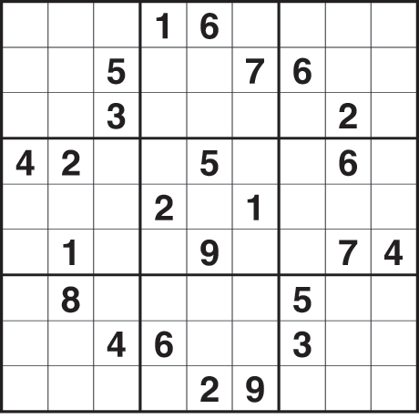
Sudoku solution

Slide 96
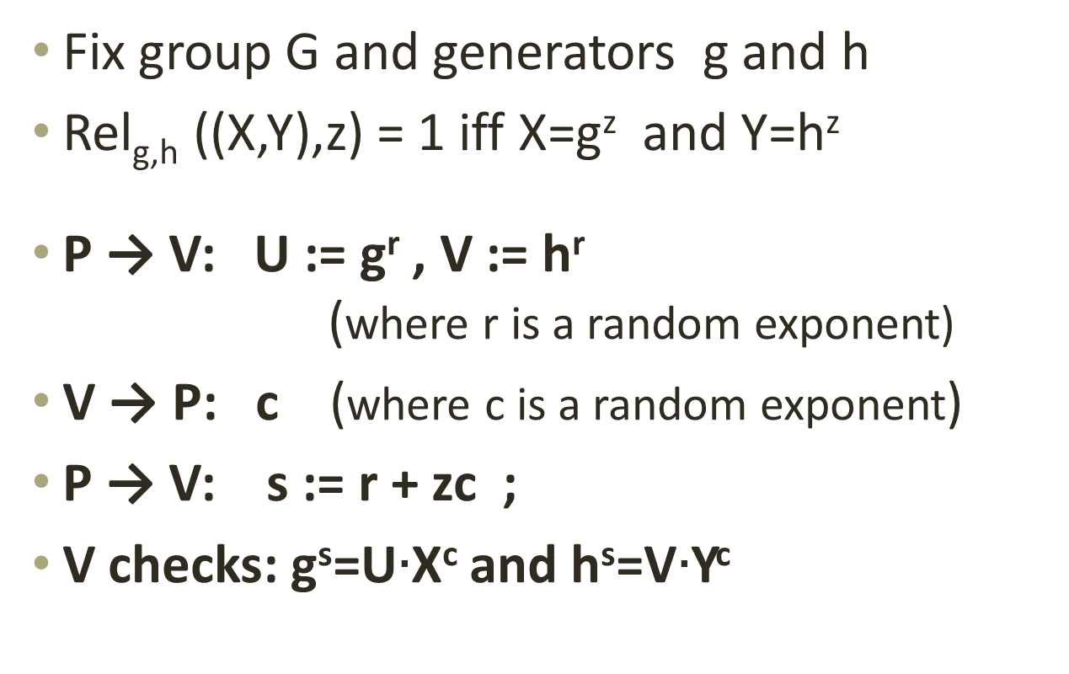
Equality of discrete logs [CP92]
Fix group G and generators g and h
Rel_{g,h} ((X,Y),z) = 1 iff X=g^{z} and Y=h^{z}
P → V: U := g^{r} , V := h^{r}
(where r is a random exponent)
V → P: c (where c is a random exponent)
P → V: s := r + zc ;
V checks: g^{s}=U$∙$X^{c} and h^{s}=V$∙$Y^{c}

Slide 97
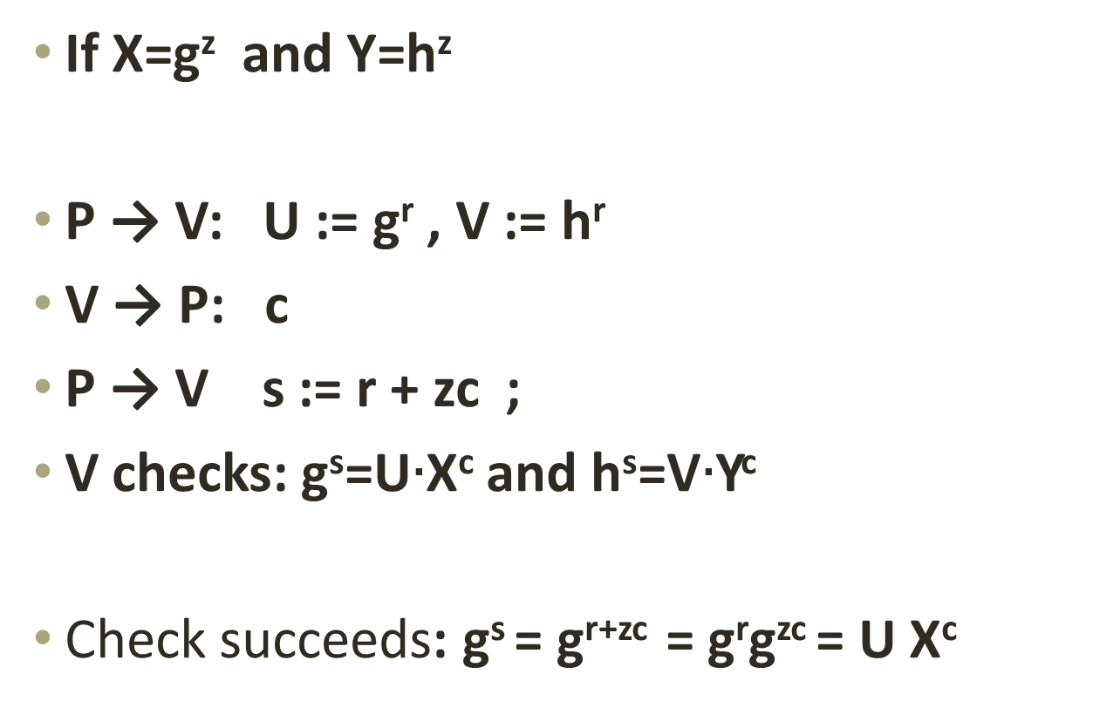
Completeness
If X=g^{z} and Y=h^{z}
P → V: U := g^{r} , V := h^{r}
V → P: c
P → V s := r + zc ;
V checks: g^{s}=U$∙$X^{c} and h^{s}=V$∙$Y^{c}
Check succeeds: g^{s} = g^{r+zc} = g^{r}g^{zc} = U X^{c}

Slide 98
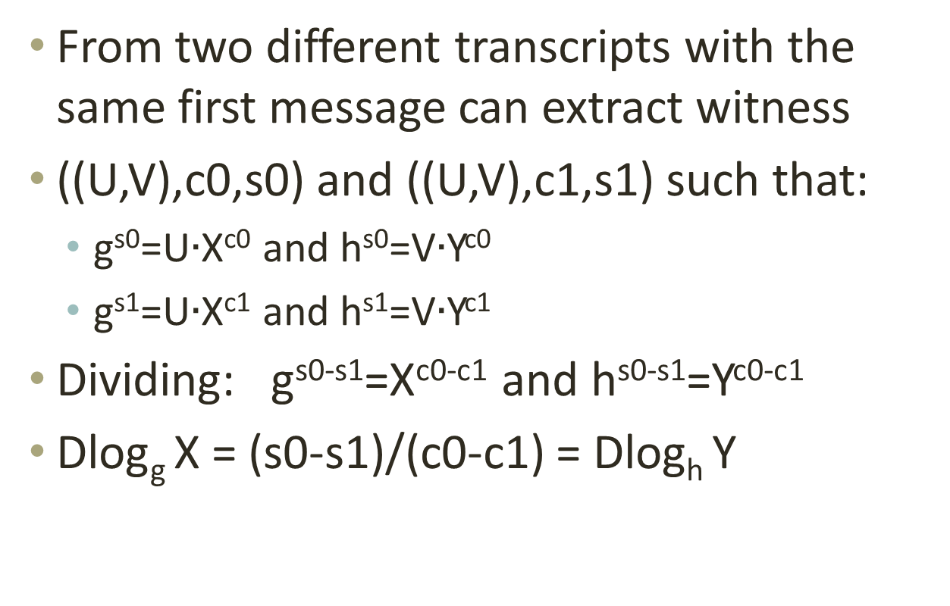
(Special) Soundness
From two different transcripts with the same first message can extract witness
((U,V),c0,s0) and ((U,V),c1,s1) such that:
  g^{s0}=U$∙$X^{c0} and h^{s0}=V$∙$Y^{c0}
  g^{s1}=U$∙$X^{c1} and h^{s1}=V$∙$Y^{c1}
Dividing: g^{s0-s1}=X^{c0-c1} and h^{s0-s1}=Y^{c0-c1}
Dlog_{g} X = (s0-s1)/(c0-c1) = Dlog_{h} Y

Slide 99
(HV) zero-knowledge
X,w
X
X
R
R
Rel(X,w)
c
c
s
s
There exists a simulator SIM that produces
transcripts that are indistinguishable from
those of the real execution (with an honest verifier).

Slide 100
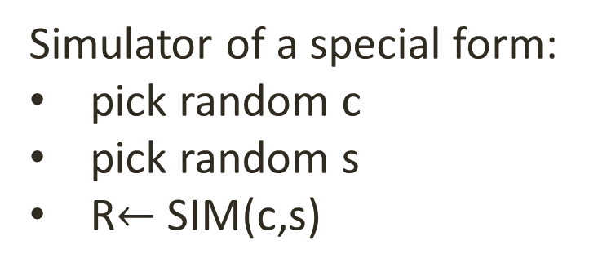
Special zero-knowledge
X,w
X
X
R
R
Rel(X,w)
c
c
s
s
Simulator of a special form:
pick random c
pick random s
R$←$ SIM(c,s)

Slide 101
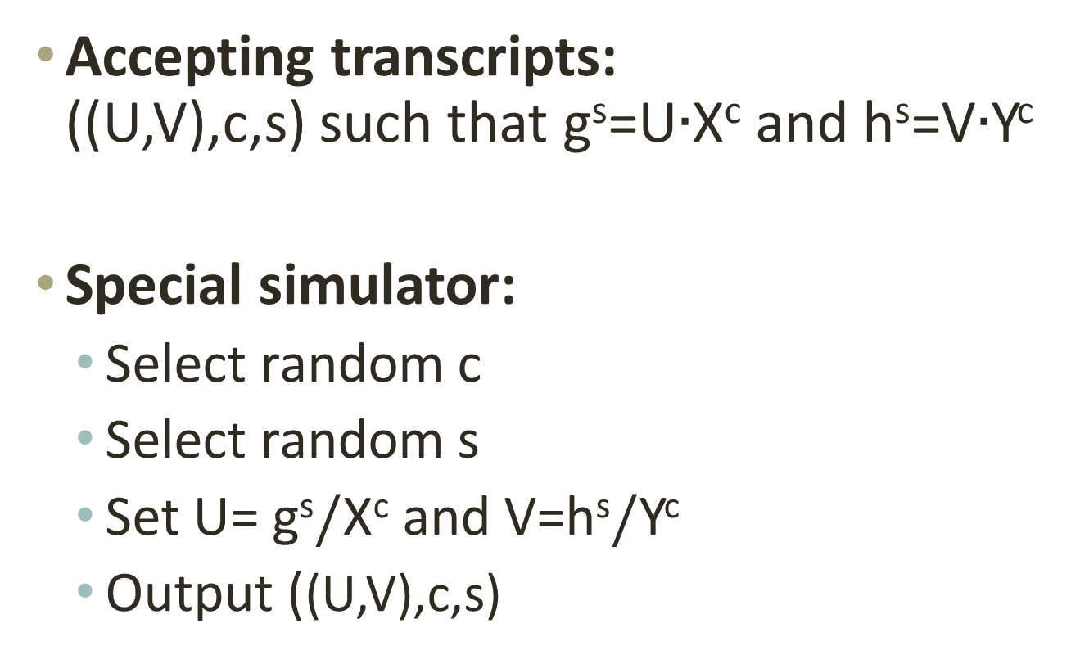
Special zero-knowledge for CP
Accepting transcripts:
((U,V),c,s) such that g^{s}=U$∙$X^{c} and h^{s}=V$∙$Y^{c}
Special simulator:
  Select random c
  Select random s
  Set U= g^{s}$/$X^{c} and V=h^{s}$/$Y^{c}
  Output ((U,V),c,s)

Slide 102
OR-proofs [CDS95,C96]
X
Y,w
Y
X,w
R1
R2
Rel1(X,w)
c1
Rel2(Y,w)
c2
s1
s2
Design a protocol for Rel3(X,Y,w) where:
Rel3(X,Y,w) iff Rel1(X,w) or Rel2(Y,w)

Slide 103
OR-proofs
X,Y
X,Y,w
R1
R2
c1
c2
c
s1
s2

Slide 104
OR-proofs
X,Y
X,Y,w
R1
R2
Rel1(X,w)
c1=c-c2
c2
c
s1
s2

Slide 105
OR-proofs
X,Y
X,Y,w
R1
R2
Rel1(X,w)
c1=c-c2
c2
c
c1,s1
c2,s2
To verify: check that c1+c2=c and that (R1,c1,s1) and (R2,c2,s2) are accepting transcripts for the respective relations.

Slide 106
Exercise
(easy) Show that the OR protocol is a complete, zero-knowledge protocol with special soundness
(easy) Design a sigma protocol to show that an exponent ElGamal ciphertext encrypts either 0 or 1.
(medium) Design a sigma protocol to show that an exponent ElGamal ciphertext encrypts either 0, 1, or 2

Slide 107
Zero-knowledge for all of NP [GMW91]
Theorem: If secure commitment schemes exist, then there exists a zero-knowledge proof for any NP language

Slide 108

Non-interactive proofs
X,w
X
$$π$$
Prover
Verifier

Slide 109
The Fiat-Shamir/Blum transform
X,w
X
X,w
X
R
R
Rel(X,w)
c
c=H(X,R)
s
s
To verify: check (R,c,s) as before.
The proof is (R,s).
To verify: compute c=H(R,s). Check (R,c,s) as before

Slide 110


NI(ZK)PoK in the RO model [FKMV12]
H(X)
P(r)
H
y
P(r)
P(r)
P(r)
$$\vec{X},\vec{π}$$
H
K
$$\vec{w}$$
$$R(\vec{X},\vec{w})$$

Slide 111
ss-NIZKPoK in the RO model
H(X)
P(r)
H
y
Sim(X,w)
Sim(X)
P(r)
P(r)
P(r)
$$$$
$$\vec{X},\vec{π}$$
H
K
$$\vec{w}$$
$$R(\vec{X},\vec{w})$$
Definition: (P,V,Sim,K) is a ss-NIZKPoK if for any efficient P, K wins with non-negligible probability.

Slide 112

Strong Fiat Shamir security
Theorem: If (P,V)$\text{i}$s an honest verifier zero-knowledge Sigma protocol , FS/B($(P,V)$) is a simulation-sound extractable non-interactive zero-knowledge proof system (in the random oracle model).

Slide 113
Three applications of NIZKPoKs
Construction of NM-CPA schemes out of IND-CPA ones (dishonest voters)
Proofs of correct decryption for tallying based on threshold decryption (dishonest tallies)
Verifiable Mixnets/Shuffles (dishonest mixers)

Slide 114
Generic construction

Slide 115

ElGamal + PoK
Let v $∈${0,1} and (R,C)=(g^{r},g^{v}X^{r})
Set u=1-v
  Pick: c,s at random
  Set A_{u}= g^{s}R^{-c} , Set B_{u}=X^{s} (Cg^{-u}) ^{–c}

Slide 116

ElGamal + PoK
  Pick A_{v} =gª, B_{v}=Xª
  h $←$H(A₀,B₀,A₁,B₁)
  c’ $←$ h - c
  s’ $←\text{a}\text{+}\text{rc}′$
  Output ((R,C), A₀,B₀,A₁,B₁,s,s’,c,c’)
Theorem: ElGamal+PoK as defined is NM-CPA, in the random oracle model if DDH holds in the underlying group.
Theorem: Enc2Vote(ElGamal+PoK) has vote secrecy, in the random oracle model.

Slide 117
Random oracles [BR93,CGH98]
Unsound heuristic
There exists schemes that are secure in the random oracle model for which any instantiation is insecure
Efficiency vs security

Slide 118

Exercise: Correct distributed ElGamal decryption
Party P_{i} has secret key xi, verification key : X_{i} = g^{xi}
Parties share secret key: x=x1 + x2 +…+xk
Corresponding public key: X=$Π$X_{i} = g^{Σxi} = g^{x}
To decrypt (R,C):
Party P_{i} computes: y_{i}$←$R^{xi} ;
Output: C/y₁y₂…y_{k} = C/R^{x}
(easy) Design a non interactive zero knowledge proof that P_{i} behaves correctly

Slide 119
Mixnet
π
σ
vote₁
vote _{π (2)}
vote _{τ (1)}
vote₂
vote _{π (N)}
vote _{τ (N)}
vote_{N}
vote _{π( 1)}
vote _{τ( 2)}
τ=π;σ

Slide 120
Mixnet
π
σ
vote₁
vote _{π (2)}
vote _{τ (1)}
vote₂
vote _{π (N)}
vote _{τ (N)}
vote_{N}
vote _{π( 1)}
vote _{τ( 2)}
τ=π;σ

Slide 121
Verifiable shuffle [KS95]
C₁
C₂
C_{i}
C_{N}
π
D_{π(2)}
D_{π(1)}
D_{π(i)}
D_{π(N)}
π
E₁
E₂
E_{i}
E_{N}
b
τ
b←{0,1}

Slide 122




Verifiable shuffle [KS95]
C₁
C₂
C_{i}
D _{π(i)}=C_{i} $∙$ Enc_{pk}(0;r_{i})
C_{N}
π
E_{π;}$$_{(i)}=D_{π(i)}$∙$Enc_{pk}(0;s_{π(i)})
D_{π (2)}
D _{π (N)}
D _{π(i)}
D _{π( 1)}
E_{π;}$$_{(i)}=C_{i}$∙$Enc_{pk}(0;r_{i}+s_{π(i)})
τ
E₁
E₂
E_{π;}$$_{(i)}
E_{N}

Slide 123

Verifiable shuffle [KS95]
Prover has C₁,C₂,…,C_{n,} D₁,D₂,…,D_{n,} permutation π and random coins r₁,r₂,…,r_{n} such that D_{i}=C_{π(i)} $∙$Enc_{pk}(0;r_{i})
The Prover selects a permutation τ , coins s₁,s₂,…,s_{n} and calculates and sends to the verifier {E_{π ;τ(i)}=D_{π(i)} $∙$Enc_{pk}(0; s _{π(i)})}_{i}
The verifier selects a random bit b and sends it to the prover
The prover answers as follows
  If b=0 then it returns (π;τ) and r₁+s _{π(1)}
  If b=1 then it returns τ, s₁,s₂,…,s_{n}
When receiving σ, q₁,q₂,…q_{n} the verifier checks that:
  If b=0: check that E_{(π;τ)(i)}=C_{i} $∙$Enc_{pk}(0;r_{i})
  If b=1: check that E_{τ(i)}=D_{i} $∙$Enc_{pk}(0;r_{i})

Slide 124
Exercise
(easy) The previous protocol is complete
(easy) The previous protocol has special soundness
  what is the soundness error?
  What do we do about it?
(easy) Prove zero-knowledgeness

Slide 125

Helios

Slide 126

Helios: vote preparation
P: v
C
$$$$
C = ENC_{PK}(v) is an encryption of the vote under a public key specific to the election
π is a proof that C encrypts a valid vote

Slide 127


Helios: voting
BB
P₁: v₁
C₁
$$₁
P₂: v₂
C₂
$$₂
P_{n}: v_{n}
C_{n}
$$_{n}

Slide 128
Helios: Tallying
BB
π
C₁
$$₁
vote _{π(2)}
C₁
C₂
C₂
$$₂
vote _{π(N)}
vote _{π(1)}
C_{N}
C_{n}
$$_{n}
C

Slide 129
Helios
BB
π
P₁: v₁
vote _{π (2)}
C₁
$$₁
P₂: v₂
C₂
$$₂
vote _{π (N)}
P_{n}: v_{n}
C_{n}
$$_{n}
vote _{π( 1)}
C

Slide 130
summary

Slide 131







Basic primitives and models

Slide 132





Techniques

Slide 133


Schemes

Slide 134
Ballot secrecy for SPS
BB₀
BB₁
PK
SK
Sees BB_{b}
C₀ $←$Vote_{PK}(h₀)
C₀
h₀,h₁
C₁ $←$ Vote_{PK}(h₁)
C₁
C
C
C
C
result
r$esult←$Tally_{SK}(BB₀)
d
win $←$ d=b
b $←\{0,1\}$
win

Slide 135
Useful, desirable, difficult to get

Slide 136
(not) The end.

